Slide 1
CYBER GYAN VIRTUAL INTERNSHIP PROGRAM Centre for Development of Advanced Computing (CDAC), Noida
Submitted By:
THUPALLI YUVASREE
Project Trainee, (August-September) 2024

Slide 2
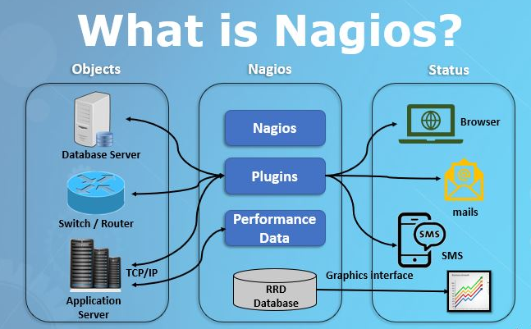
TOPIC NAME
Performing Nagios Host Monitoring System using Linux Guardian System

Slide 3
PROBLEM STATEMENT
The reliability and efficiency of network infrastructure are critical for ensuring system stability, security, and performance. Unmonitored network systems are prone to failures and security breaches, which may lead to downtime and significant operational disruption. This project addresses the challenge of implementing a host monitoring system that proactively detects and alerts administrators to potential issues within the network before they escalate into major problems.
PROJECT DOMAIN : Network Monitoring.

Slide 4
OBJECTIVE
To implement a comprehensive monitoring solution using Nagios Core on Kali Linux that monitors hosts and services across the network. This includes extending the monitoring capabilities with custom Linux Guardian scripts to reinforce security and detect system anomalies such as failed SSH login attempts, service unavailability, and high system resource usage.

Slide 5
TECHNOLOGY/TOOLS TO BE USED
Nagios Core (for monitoring hosts and services)
NRPE (Nagios Remote Plugin Executor) (to monitor remote hosts)
Kali Linux (as the monitoring environment)
Linux Guardian System (custom scripts for security enhancement)
Apache Web Server (to host Nagios Web UI)
SSL/TLS Encryption (for secure communication between server and hosts)
Firewalls and SSH (for secure connections)

Slide 6
ABOUT THE PROBLEM STATEMENT
In any modern IT environment, ensuring continuous uptime and optimal performance of network infrastructure is essential for business operations. Manual monitoring of network infrastructure is not feasible due to the complexity and size of most enterprise environments. Moreover, unforeseen failures, security breaches, and resource bottlenecks can lead to costly downtime and performance degradation.
Without an automated and reliable monitoring system in place, administrators are often reactive to issues rather than proactive, resulting in problems being identified only after they have impacted the system, leading to:
Network downtime which affects productivity and services.
Security breaches which may go unnoticed, potentially leading to data loss or unauthorized access.
Performance bottlenecks which affect the user experience and system reliability.

Slide 7
WHAT ARE THE REASONS BEHIND THE PROBLEM?
Complexity of network environments: As businesses grow, the number of devices, applications, and servers increases exponentially, making manual monitoring impractical.
Lack of automated solutions: Many organizations rely on legacy or manual systems for monitoring, which are inefficient and prone to errors.
Cybersecurity risks: With the increase in cyberattacks, systems without real-time security monitoring are vulnerable to breaches.
Resource unpredictability: Server loads fluctuate, and without proactive monitoring, resources can be depleted unexpectedly, causing outages.

Slide 8
IMPLEMENTATION DETAILS
1. Setting Up Nagios on Kali Linux:
Install dependencies (Apache, PHP, libgd) to support the Nagios web interface.
Download, compile, and install Nagios Core from the source.
Configure the Nagios web interface and set up an admin user for accessing the dashboard.
2. Adding Monitoring Capabilities:
Install Nagios Plugins to enable essential host and service monitoring.
Configure NRPE on remote Linux hosts to allow Nagios to monitor system health metrics like CPU load, disk usage, and memory.
3. Custom Monitoring Scripts with Linux Guardian:
Implement custom bash scripts for additional security, such as monitoring for failed SSH login attempts.
Integrate these scripts with Nagios to automate alerts for abnormal security events.
4. Configuration of Hosts and Services:
Define host and service configurations within Nagios to monitor various network devices and services. Add details like maximum check attempts, alert intervals, and notification settings.
5. Setting Up Secure Communication:
Use SSL/TLS to encrypt data between the Nagios server and remote hosts.
Secure access to the Nagios web interface using HTTPS and implement IP restrictions for admin access.

Slide 9
KEY ISSUES
Lack of real-time monitoring: Administrators are often unaware of critical failures until after they occur.
Absence of proactive alerts: Without timely notifications, small issues can escalate into major problems.
Resource exhaustion: Systems may run out of CPU, memory, or disk space without warning, causing crashes.
Security vulnerabilities: Unauthorized access attempts, malware infections, or service disruptions may go undetected.
Manual tracking: Trying to manually monitor servers or services leads to human errors and delayed responses.

Slide 10
THREATS & COUNTERMEASURES
Unauthorized Access:
Threat: Attackers may gain access to the Nagios server or hosts.
Countermeasure: Implement strong password policies, multi-factor authentication (MFA), and restrict IP access.
2. Denial of Service (DoS/DDoS):
Threat: Overloading the Nagios server with traffic, leading to downtime.
Countermeasure: Use rate limiting, firewalls, and load balancers to mitigate large traffic bursts.
3. Man-in-the-Middle (MitM) Attacks:
Threat: Interception of unencrypted data between server and hosts.
Countermeasure: Secure communication using TLS/SSL, SSH tunnels, or VPNs.

Slide 11
4. Exploiting Unpatched Software:
Threat: Vulnerabilities in outdated Nagios versions may be exploited.
Countermeasure: Regularly update Nagios, plugins, and OS software to eliminate vulnerabilities.
5. Remote Code Execution:
Threat: Malicious code executed via insecure plugin scripts.
Countermeasure: Audit custom scripts, enforce strict security policies (SELinux, AppArmor), and validate all inputs.

Slide 12
RECOMMENDATIONS
Encrypt Communication: Ensure SSL/TLS is used for all server-host communication to prevent data interception.
Role-Based Access Control (RBAC): Restrict administrative access to critical Nagios configurations.
Regular Software Updates: Periodically update Nagios and plugins to address new vulnerabilities.
Backup Configurations: Implement an automated backup strategy for Nagios configurations and logs.
Scalability: As the network grows, consider load balancing and high-availability setups for Nagios.

Slide 13
CONCLUSION
The Nagios Host Monitoring System provides an efficient way to monitor hosts, services, and network devices for performance and security issues. By integrating custom Linux Guardian scripts, this system can also enhance security by detecting unauthorized access attempts or suspicious activities. A well-configured Nagios environment allows network administrators to detect problems early and minimize downtime or security incidents.

Slide 14
THANK YOU

